Slide 1
The Mechanism of Circadian Clock
丁啟祐¹ and 邱紹庭²
¹昆蟲系
²生醫電資所
1/7, 2019. NTU
Notes:
Hi ! I’m Shao-Ting
It’s my pleasure to share my project today, and thanks the organization committee for choosing me as oral presentation.
Today, I’m going to introduce my project about Mitochondrial retrograde signalling modelling by differential-equation based framework

Slide 2


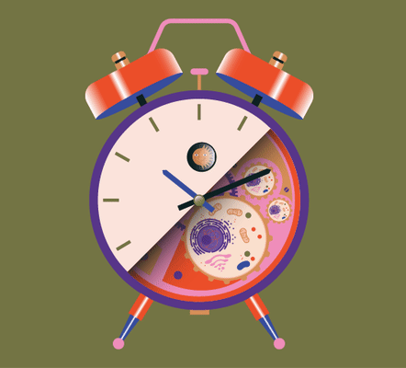

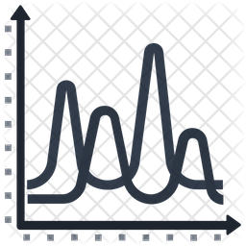

Outline
The Mechanism of Circadian Clock
Part I - What is Circadian Clock? What makes it ticks?
History of
Discovery
PER Pathway
Part II - Why molecular clock ticks?
Negative
Feedback
Delay
Limit Cycle

Slide 3
Outline
Speaker: 丁啟祐, 昆蟲系
The Mechanism of Circadian Clock
Part I - What is Circadian Clock? What makes it ticks?
History of
Discovery
PER Pathway
Part II - Why molecular clock ticks?
Negative
Feedback
Delay
Limit Cycle

Slide 4
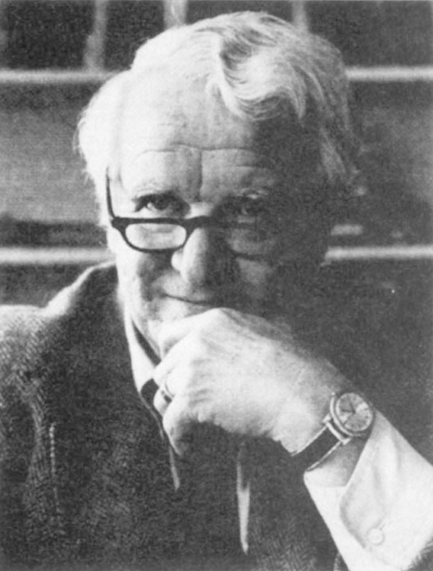
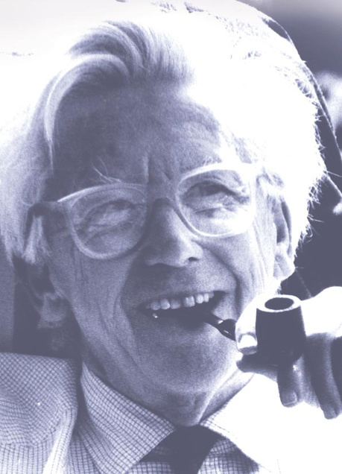
History of Circadian Discovery
Colin Pittendrigh (1918-1996)
Jürgen Aschoff (1913-1998)
https://www.nature.com/articles/381024a0
https://www.nature.com/articles/24750
Notes:
科林·皮登德里赫與他的朋友和同事尤金·阿紹夫（Jurgen Aschoff）一起領導了一個長達十年的工作，該工作確立了幾乎所有形式的真核生物都存在於幾乎所有真核生物中的生物鐘。

Slide 5


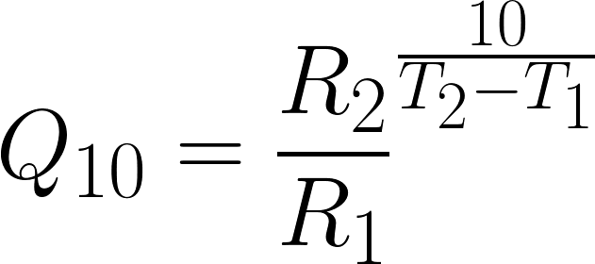
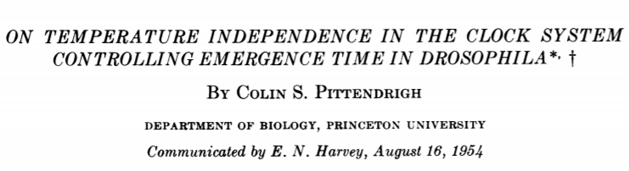
History of Circadian Discovery
生物時鐘受到溫度補償效應
Colin Pittendrigh (1918-1996)
R : Rate ; T: Temperature ; Q : ratio of rates
https://www.nature.com/articles/381024a0
Notes:
在沒有來自環境的暫時提示（即在實驗室中恆定條件下）​​的情況下，節律持續存在。它的羽化時期只有的
隨著環境溫度的微小變化（精確計時下）。
溫度會延遲約日週期
生活在持续黑暗，但温度分别为 16、21 和 26℃ 3 种条件下的果蝇羽化的周期均维持在 24 h 左右，即在一个较为宽泛的温度范围内，生物钟周期长度具有“温度补偿”(temperature compensation)的特性

Slide 6
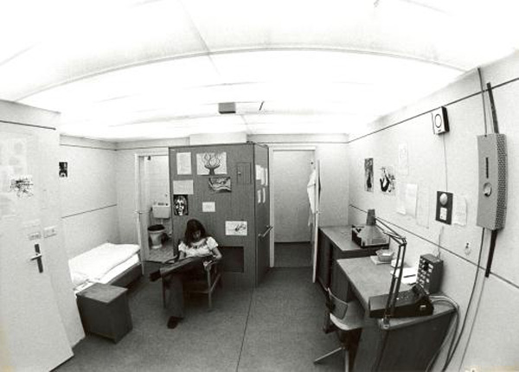
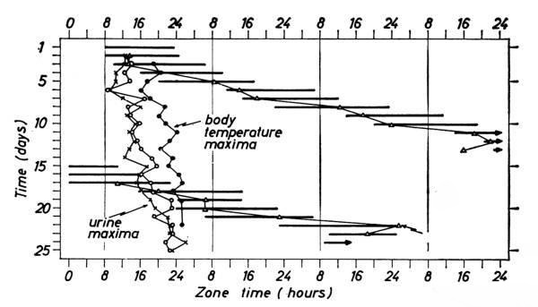
History of Circadian Discovery
https://www.pravda-tv.com/2013/07/chronobiologie-schlaflabor-im-bunker/
https://www.britannica.com/video/179763/subjects-bunker-experiment-exposure-rhythms-light
Jürgen Aschoff (1913-1998)
Notes:
每日的清醒時間延遲
身體具有多個時鐘調控不同活動
环境中多种信号，例如光、温度、进食等可作为授时因子(time giver)调节机体的昼夜节律相位。

Slide 7
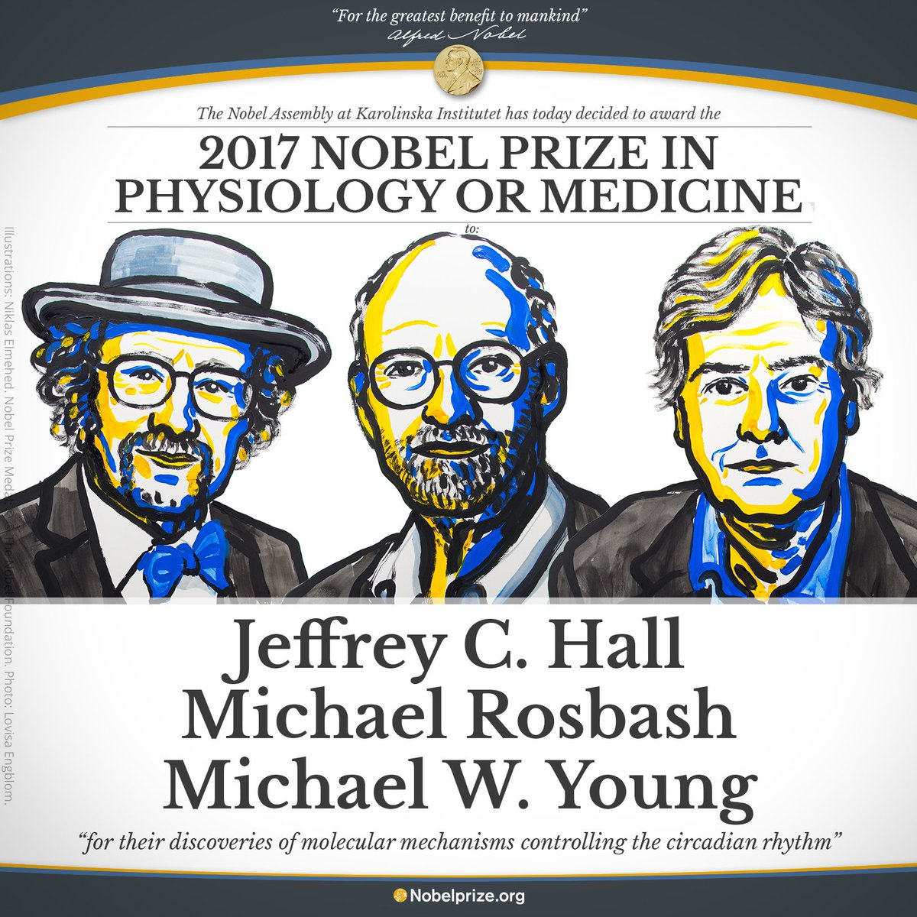
Molecular Mechanism of Circadian Pathway
https://www.thenewslens.com/article/103382
Notes:
Jeffrey C. Hall霍爾和Michael Rosbash羅斯巴希證明了per基因的轉錄（作成mRNA）和轉譯（作成PER蛋白）的基因活動，定序per基因
Michael W. Young楊恩在果蠅的第二對染色體上，找到另一個重要的時鐘基因，當這個基因突變時，果蠅也失去了休息／活動周期。(timeless)

Slide 8
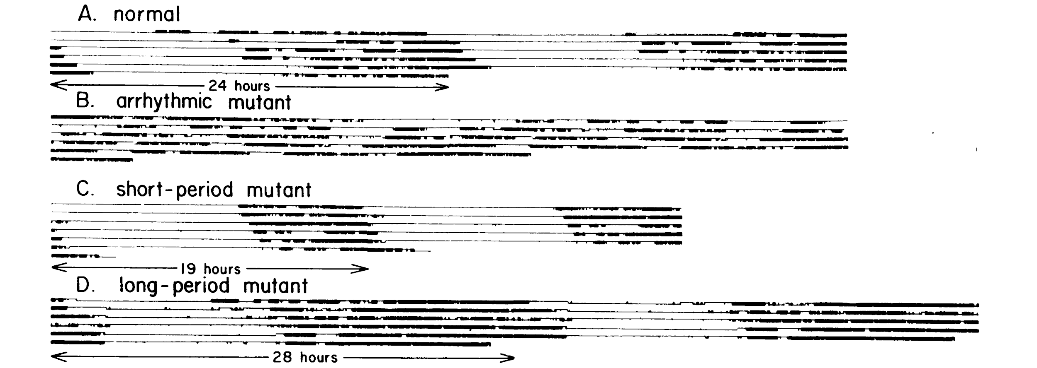
Molecular Mechanism of Circadian Pathway
(J. Konopka,1971)
黑點: 活動時間; 白:無活動時間
Notes:
A.正常，有週期，平均24.5小時
B.突變，無週期
C.突變，有週期，平均19.5小時
D.突變，有週期，平均28.5小時

Slide 9
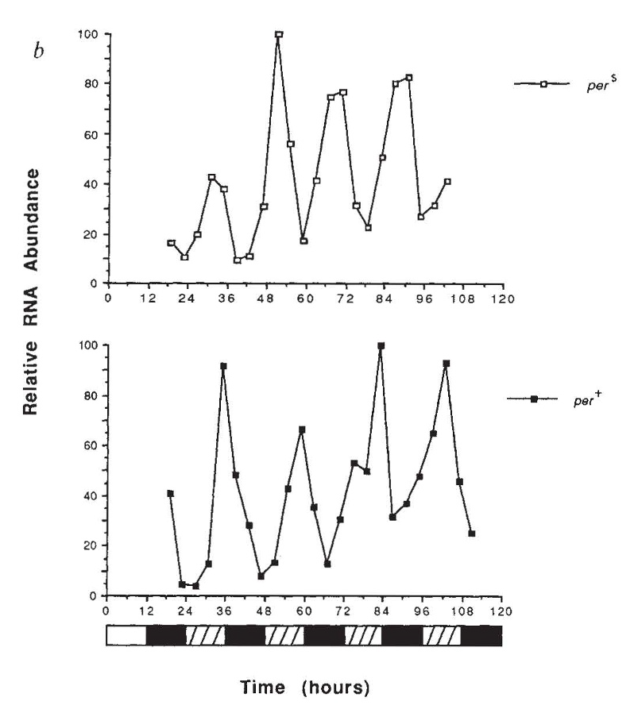
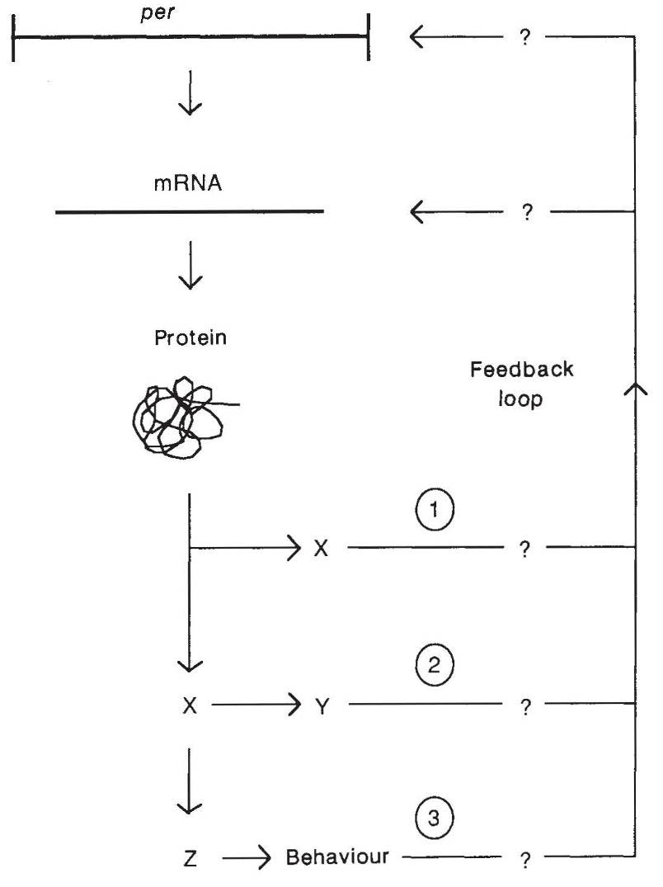
Molecular Mechanism of Circadian Pathway
PER 表現量
短週期
wild type
環境光照
(C. Hall&Michael Rosbash,1990)
Notes:
per locus either shorten ( per^s), lengthen (per^L)or essentially abolish ( per^o)

Slide 10
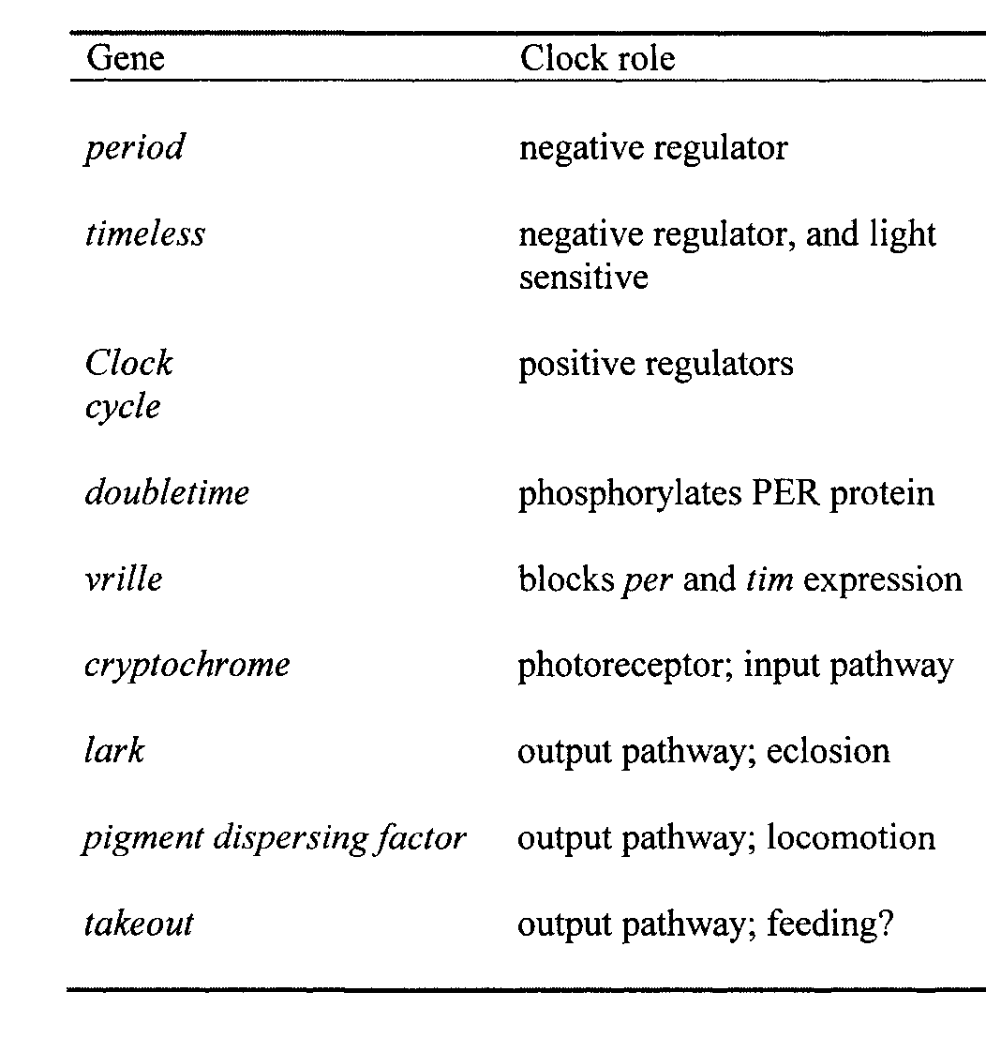
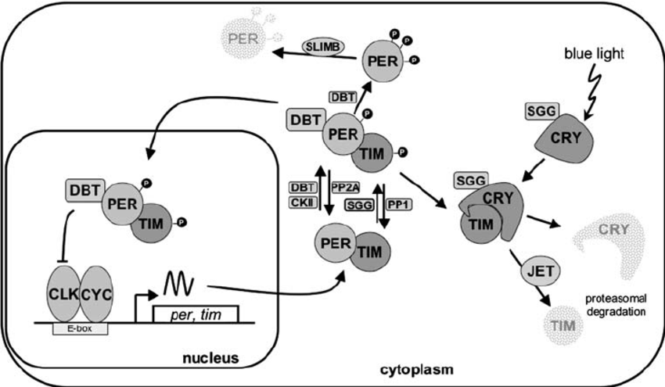
Molecular Mechanism of Circadian Pathway
Negative feedback
PER
TIM
DBT
CRY
Promote PER procuction
PER decay
Cascading
Phosphorylation
Input
Dubruille, R. et al. 2008
Notes:
cryp-to-chrome(隱色素)接受到陽光後會快速的把timeless分解
doubletime kinase會磷酸化PER，使單獨的PER protein被分解(因磷酸化標記)
而PER與TIM會形成異結合二具體(heterodimer)，故不會被DBT分解
突變個體與正常個體的生理時鐘差異在於DBT(doubletime kinase)消除PER的速率

Slide 11
Outline
Speaker: 邱紹庭, 生醫電資所
The Mechanism of Circadian Clock
Part I - What is Circadian Clock? What makes it ticks?
History of
Discovery
PER Pathway
Part II - Why molecular clock ticks?
Negative
Feedback
Delay
Limit Cycle
Notes:
2min

Slide 12
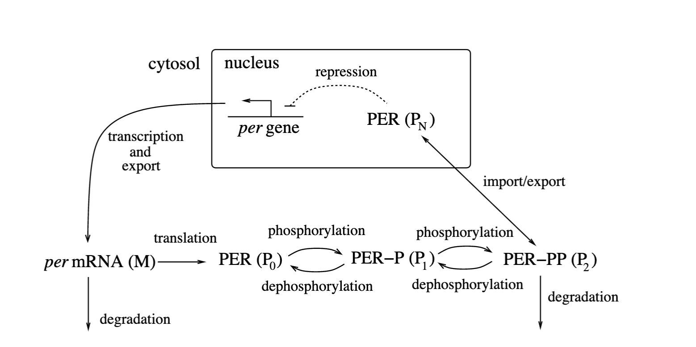
Model of Circadian Clock
Why circadian clock ticks?
Negative Feedback
Delay
Input
[1] Goldbeter, A. and Berridge, M.J. 1996. [2] Ingalls B. Mathematical Modeling in Systems Biology - an Introduction (2016)

Slide 13
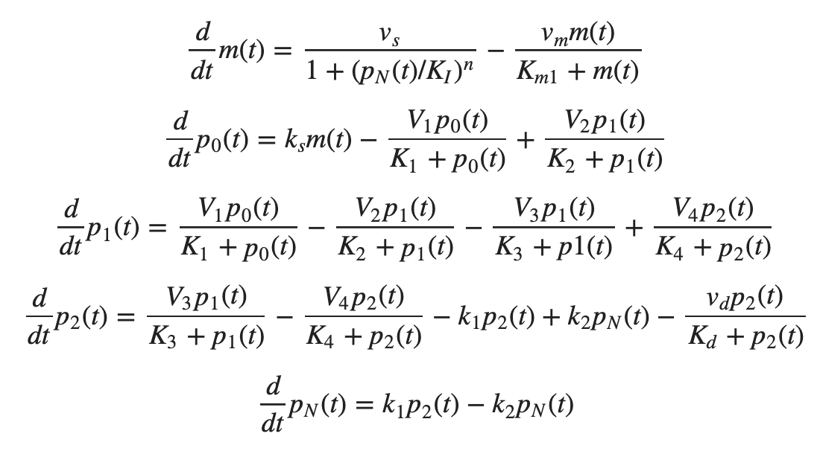

Mathematical Model of Circadian Clock
Why circadian clock ticks?
Rate of reaction
[1] Goldbeter, A. and Berridge, M.J. 1996. [2] Ingalls B. Mathematical Modeling in Systems Biology - an Introduction (2016)

Slide 14

Negative Feedback
Notes:
21s

Slide 15
Negative Feedback
[1] Goldbeter, A. and Berridge, M.J. 1996. [2] Ingalls B. Mathematical Modeling in Systems Biology - an Introduction (2016)

Slide 16
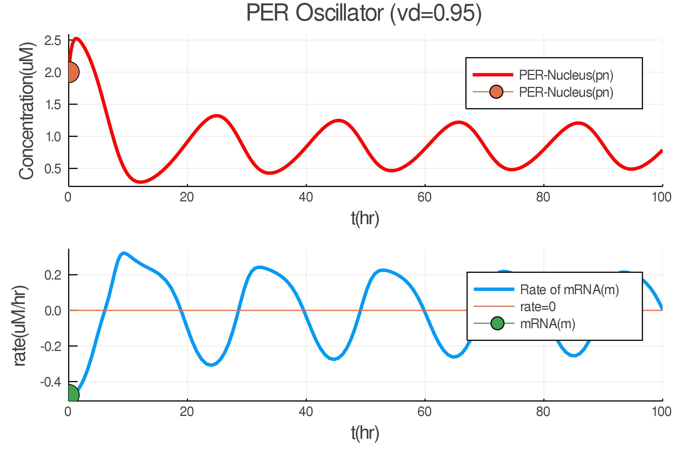

Negative Feedback
Concentration
Rate
Goldbeter, A. and Berridge, M.J. 1996.

Slide 17
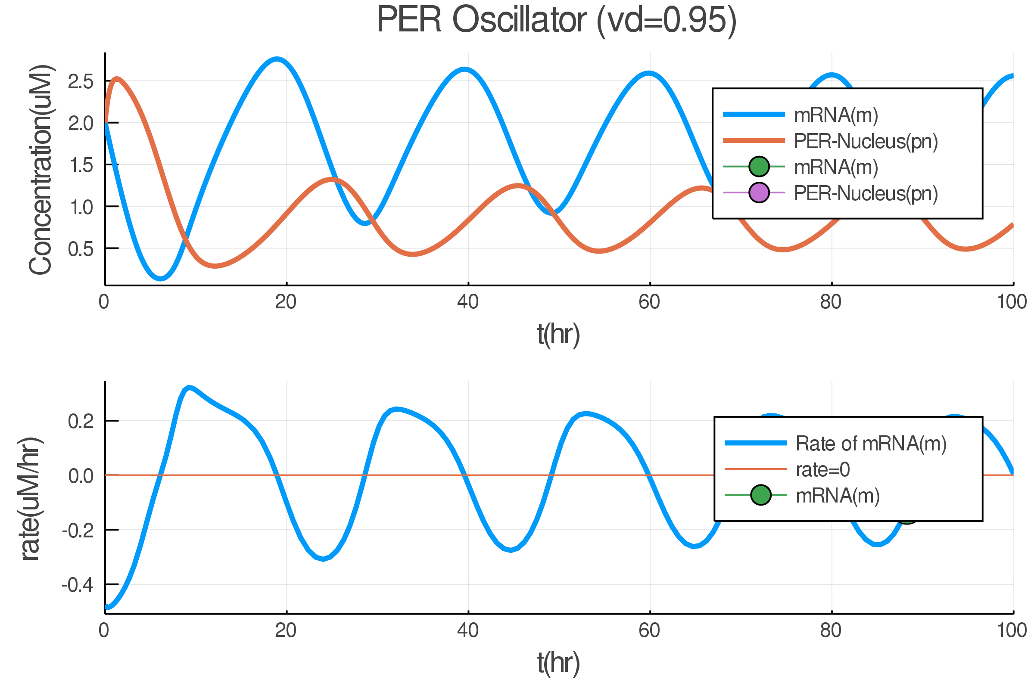
Negative Feedback
Negative feedback makes the system stable.
Concentration
Rate
Goldbeter, A. and Berridge, M.J. 1996.

Slide 18
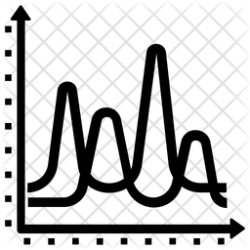
Delay
Notes:
1m04sec

Slide 19
Delay
Delayed feedback is made by cascading phosphorylation.
[1] Goldbeter, A. and Berridge, M.J. 1996. [2] Ingalls B. Mathematical Modeling in Systems Biology - an Introduction (2016)

Slide 20
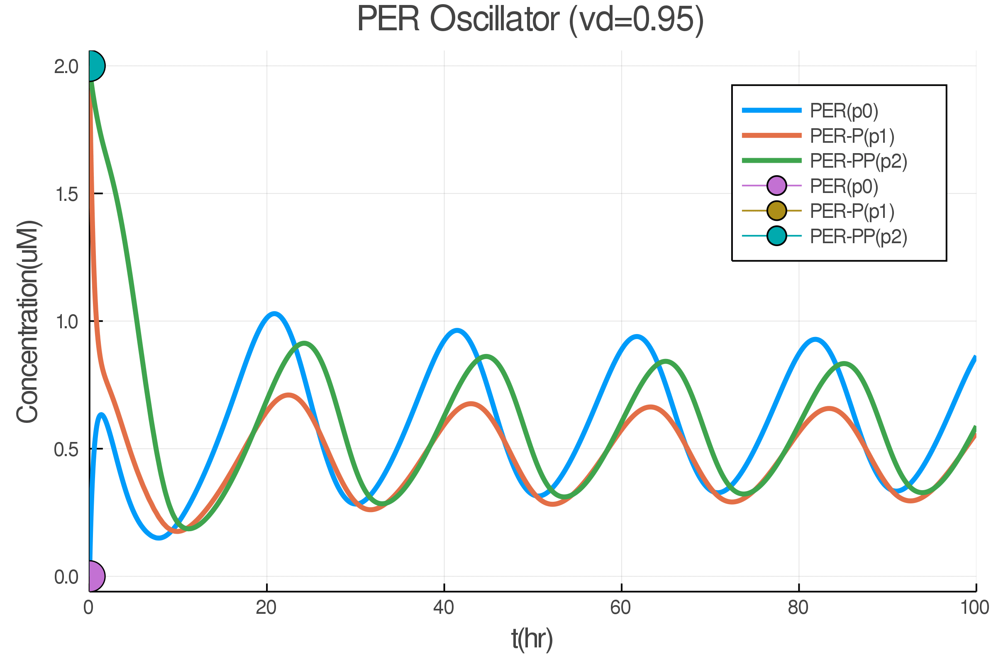

Delay
Delayed feedback made the system unstable.
Cascading phosphorylation
Goldbeter, A. and Berridge, M.J. 1996.

Slide 21
Limit Cycle

Slide 22
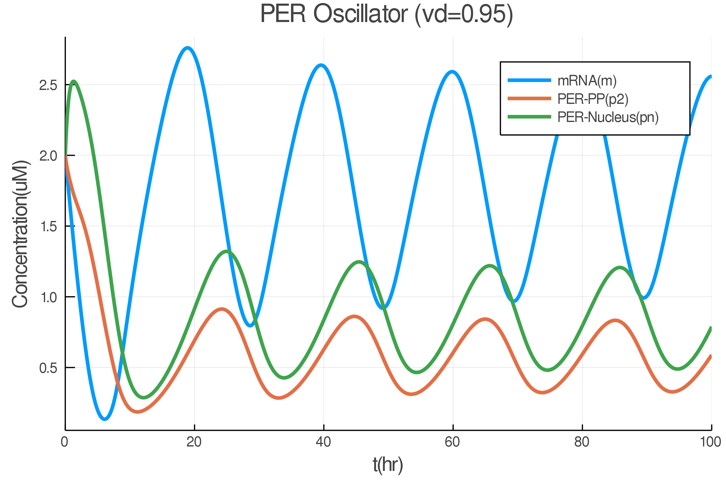

Limit Cycle
The Period of Circadian Clock can be Modulated by Decay of PER
Vd
[1] Goldbeter, A. and Berridge, M.J. 1996. [2] Ingalls B. 2016

Slide 23
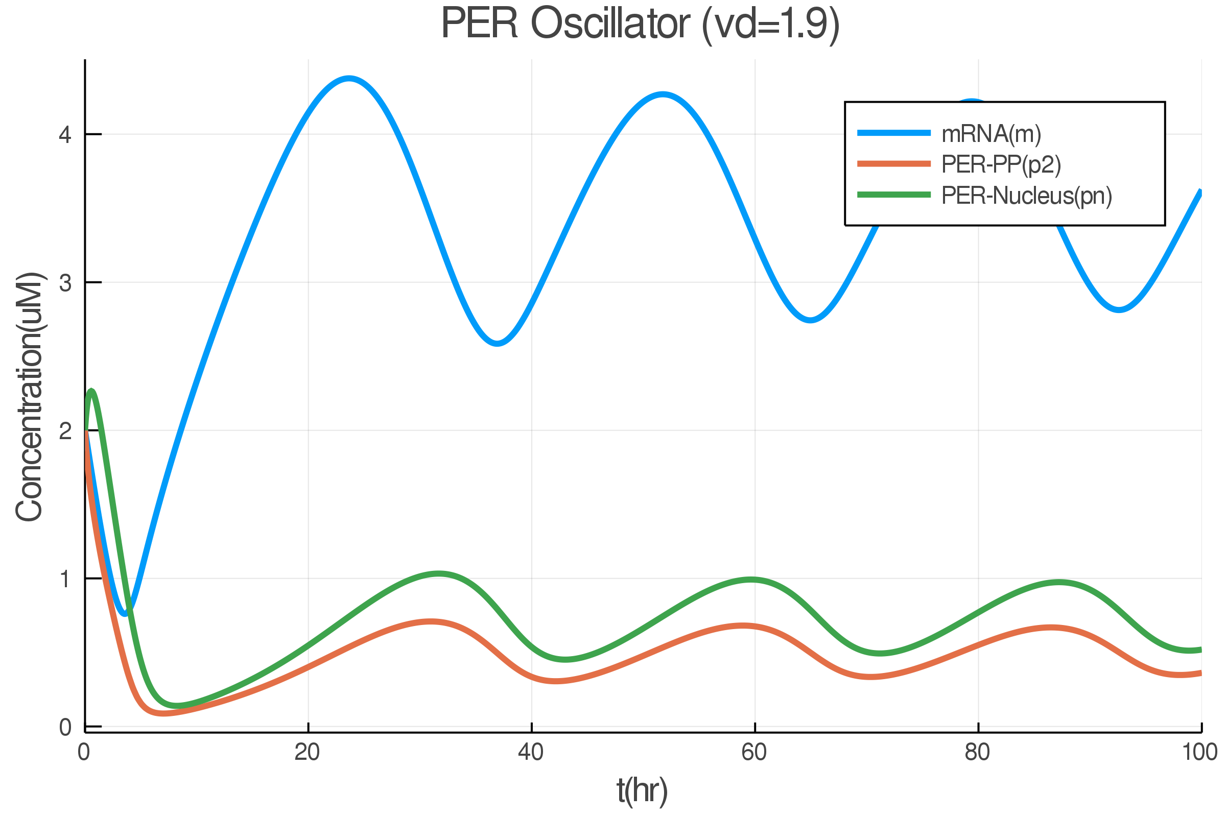
Limit Cycle
The Period of Circadian Clock can be Modulated by Decay of PER
Vd
[1] Goldbeter, A. and Berridge, M.J. 1996. [2] Ingalls B. 2016

Slide 24
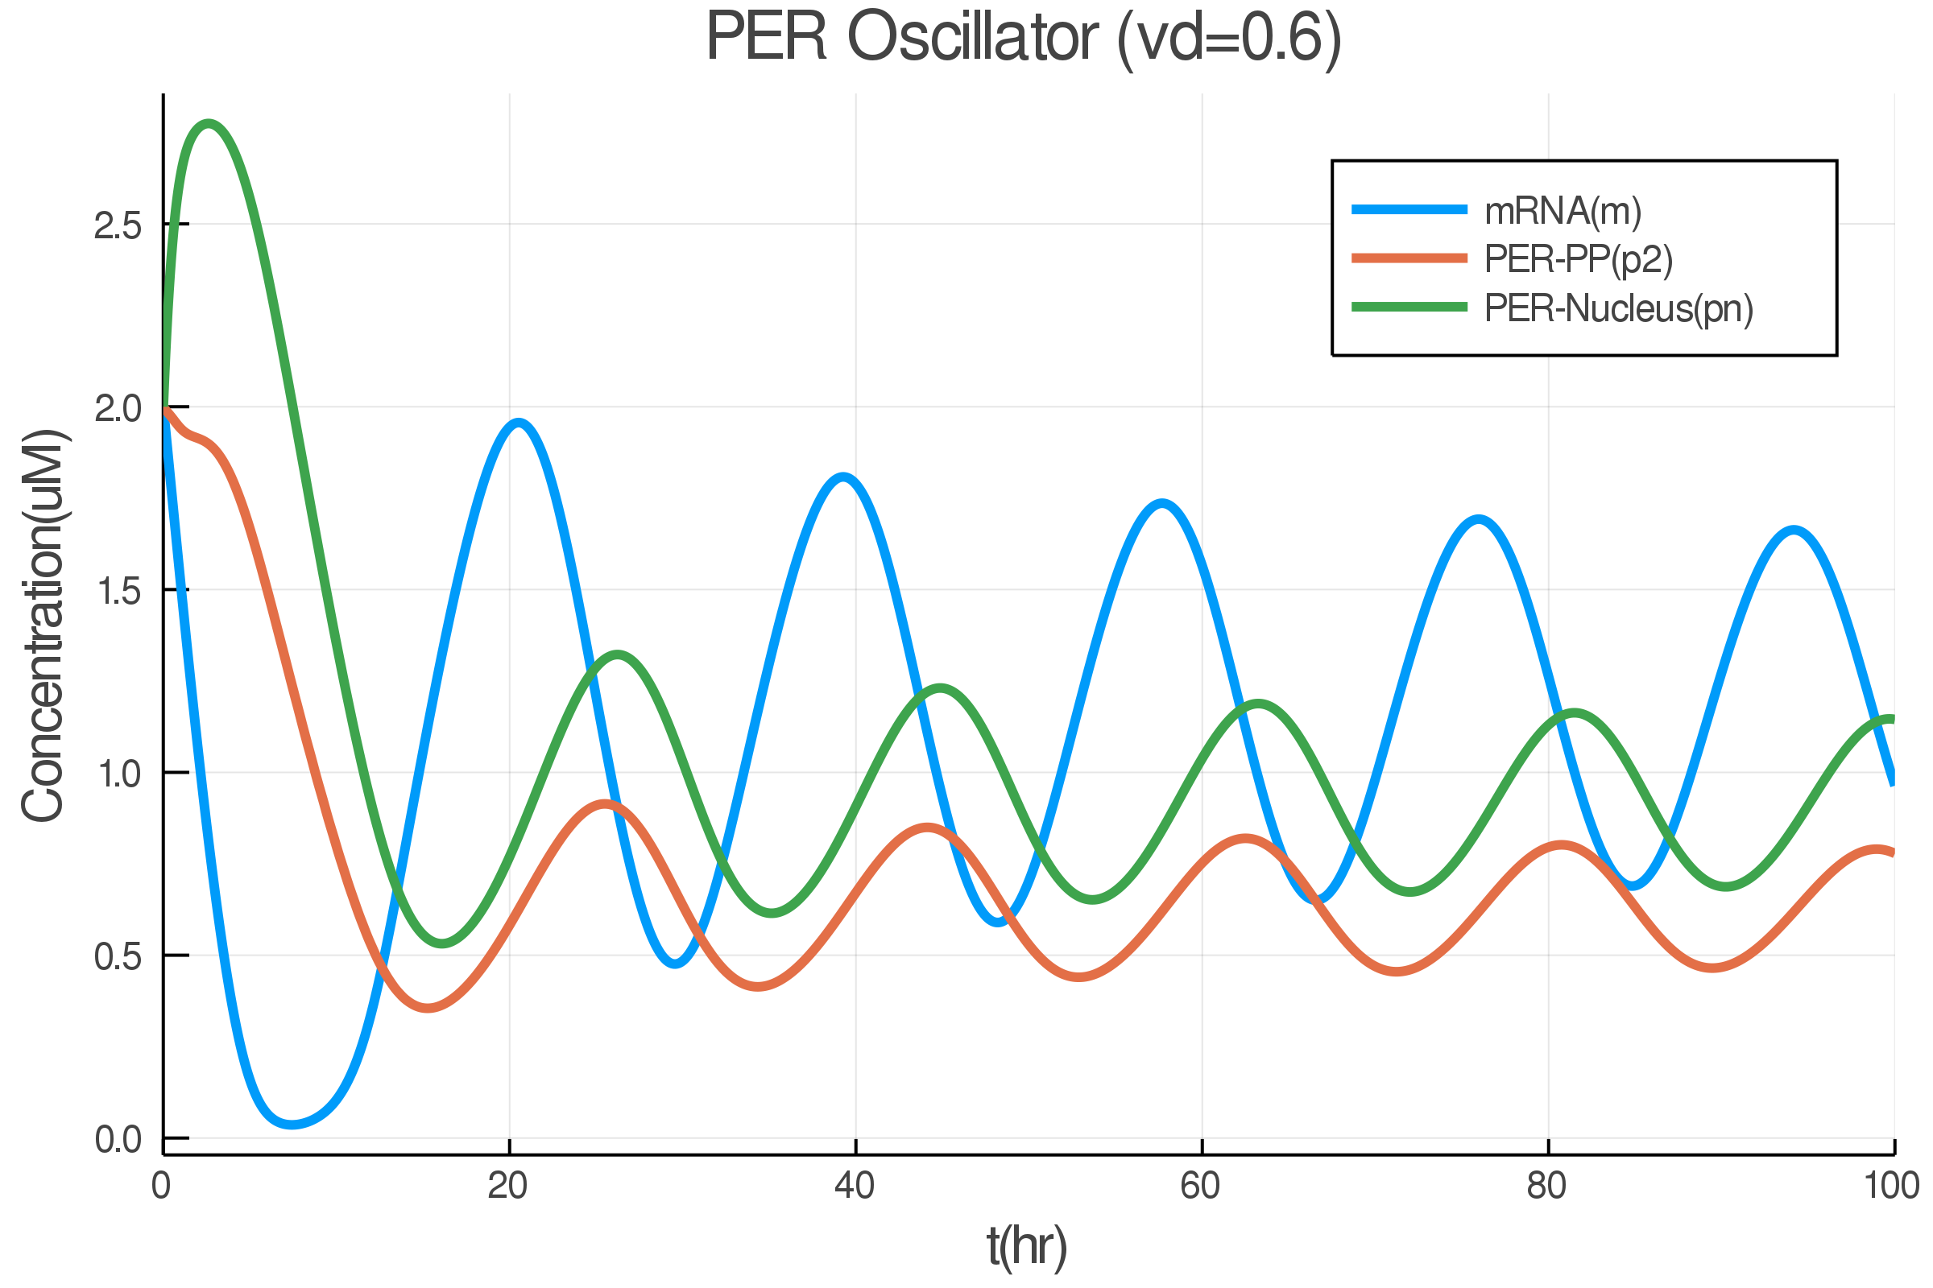
Limit Cycle
The Period of Circadian Clock can be Modulated by Decay of PER
Vd
[1] Goldbeter, A. and Berridge, M.J. 1996. [2] Ingalls B. 2016

Slide 25
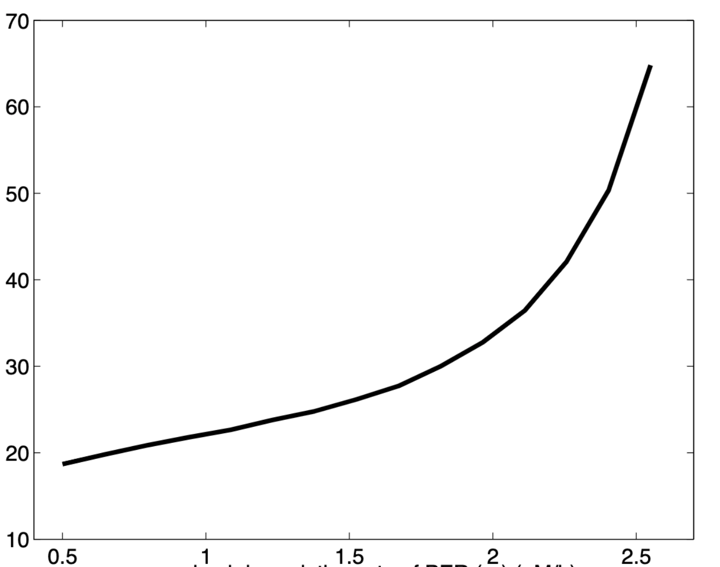
Limit Cycle
The PER clock doesn’t alway oscillates.
Stable
Oscillating
Unstable
0
0.45 uM/hr
2.46 uM/hr
Does circadian clock oscillate with any PER decay rate?
Period(hr)
No, circadian clock can’t achieve any duration of period either.
PER decay rate(uM/hr)
Ingalls B. 2016

Slide 26
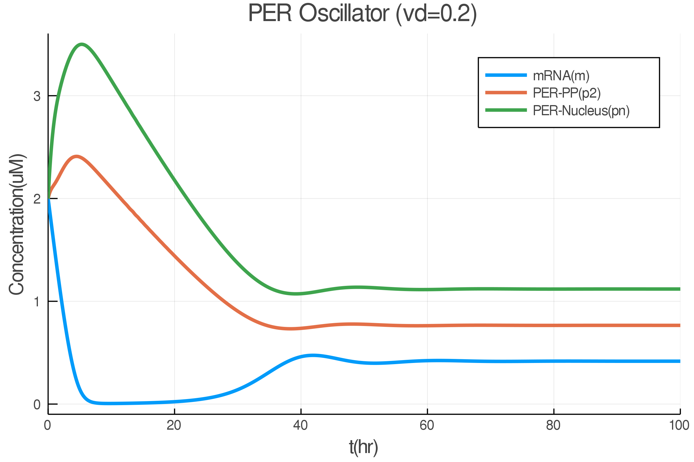
Limit Cycle
The PER clock doesn’t alway oscillates.
Vd
Stable
Oscillating
Unstable
0
0.45 uM/hr
2.46 uM/hr
[1] Goldbeter, A. and Berridge, M.J. 1996. [2] Ingalls B. 2016

Slide 27
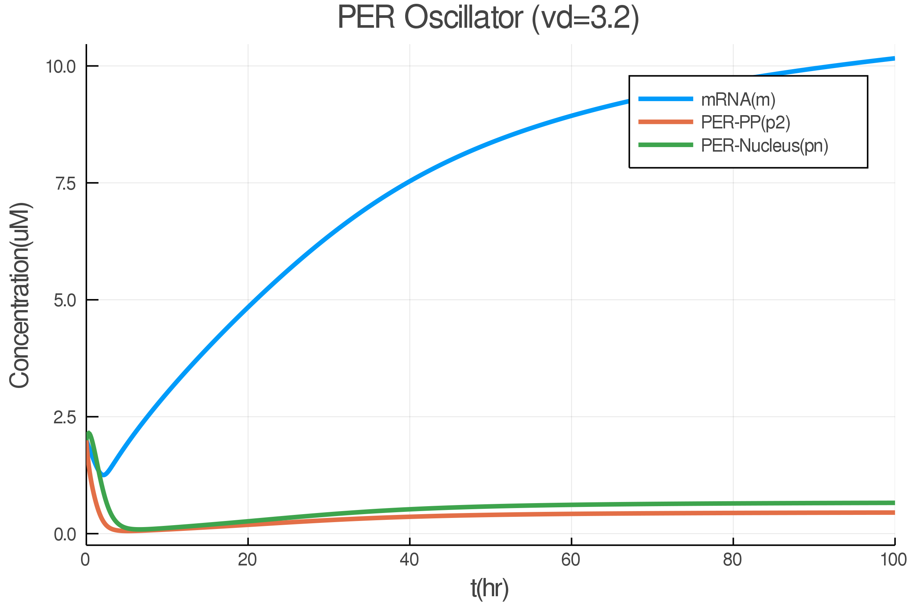
Limit Cycle
The PER clock doesn’t alway oscillates.
Vd
Stable
Oscillating
Unstable
0
0.45 uM/hr
2.46 uM/hr
[1] Goldbeter, A. and Berridge, M.J. 1996. [2] Ingalls B. 2016

Slide 28
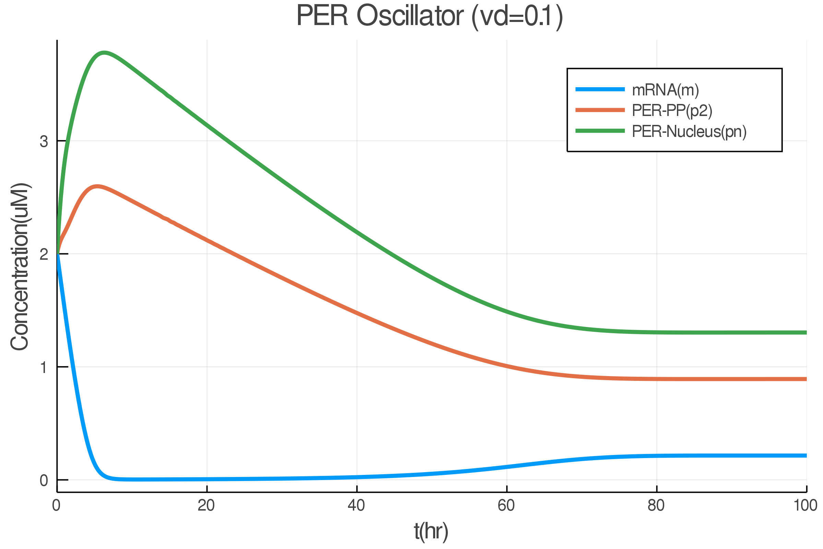
Limit Cycle
The PER clock doesn’t alway oscillates.
Vd
Stable
Oscillating
Unstable
0
0.45 uM/hr
2.46 uM/hr
[1] Goldbeter, A. and Berridge, M.J. 1996. [2] Ingalls B. 2016

Slide 29
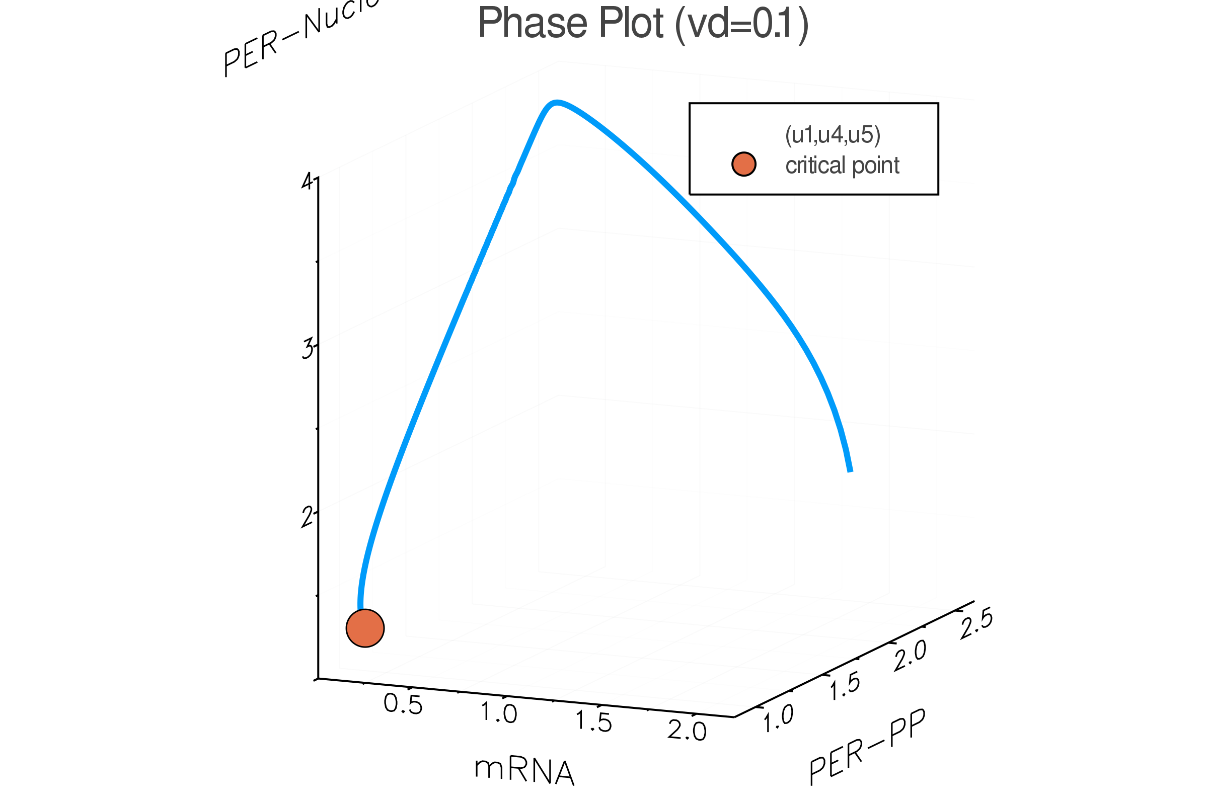
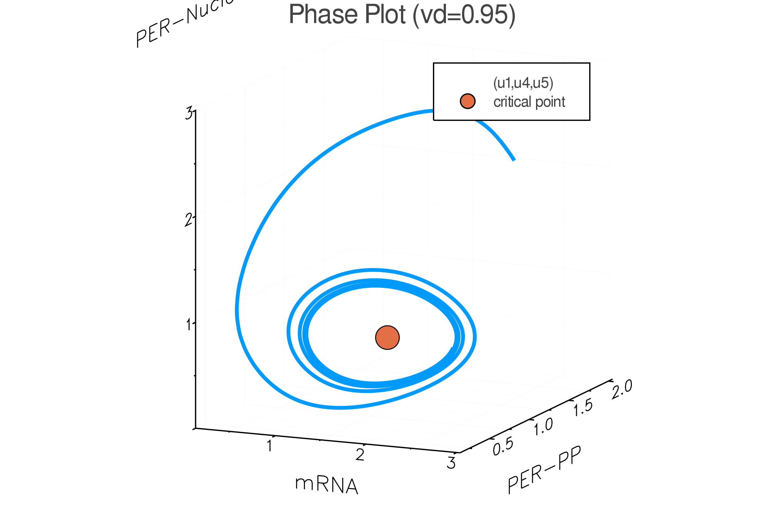
Limit Cycle
The PER clock doesn’t alway oscillates.
Vd
Stable
Oscillating
Unstable
0
0.45 uM/hr
2.46 uM/hr
[1] Goldbeter, A. and Berridge, M.J. 1996. [2] Ingalls B. 2016

Slide 30
Conclusions
生物時鐘由 PER 蛋白調控，其包含溫度, 藍光等因素影響 PER 與 TIM (防止PER降解的蛋白) 的結合。
生物時鐘的震盪需要 negative feedabck 和 delay 匹配提供穩定與不穩定的因子。

Slide 31

Snap it if your want to know more...
Thank you.
Source code and supplemental material.
https://github.com/stevengogogo/CircadianSimulation
{b06612039, r07945001}@ntu.edu.tw

Slide 32


Supplemental Material
East-West Jetlag
Jetlag

Slide 33
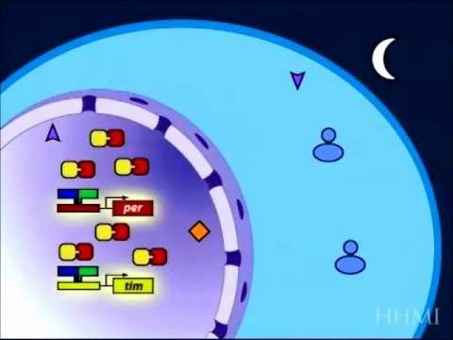
https://www.youtube.com/watch?v=zB4VBpv9rn4
Notes:
cryp-to-chrome(隱色素)接受到陽光後會快速的把timeless分解
doubletime kinase會磷酸化PER，使單獨的PER protein被分解(因磷酸化標記)
而PER與TIM會形成異結合二具體(heterodimer)，故不會被DBT分解
突變個體與正常個體的生理時鐘差異在於DBT(doubletime kinase)消除PER的速率

Slide 34
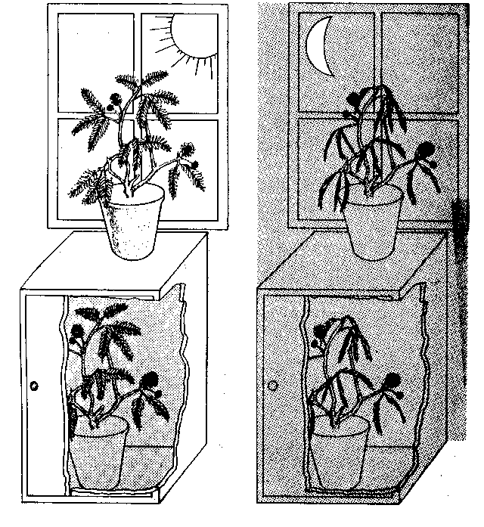
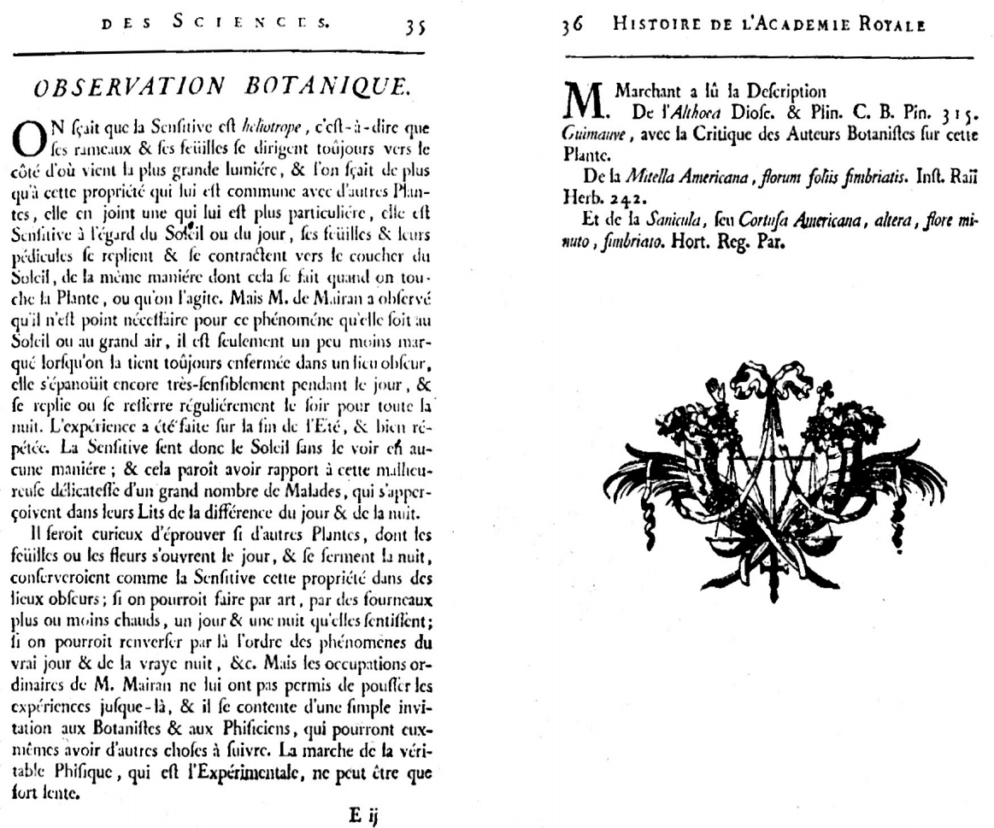
History of Circadian Discovery
http://www.bibnum.education.fr/sciencesdelavie/biologie/observation-botanique
Notes:
法國天文學家－德麥蘭Jean-Jacques de Mairan觀察到含羞草即使處在沒有亮與暗的變化的環境下，葉子也能夠有開與關的轉換，而且這個週期約是22.5小時。也就是說，葉子的變化每天會比前一天提早約1.5～2小時。
(1729年)為第一份關於含羞草的約日週期活動記錄

Slide 35
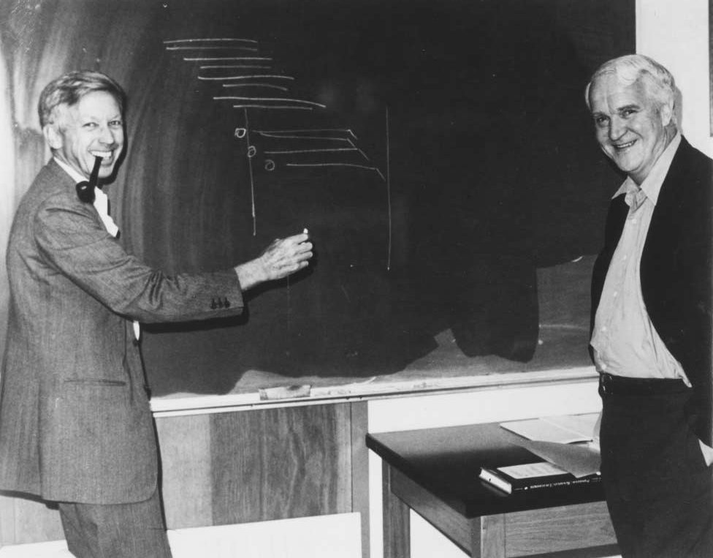
History of Circadian Discovery
1)Free running period和Entrainment的證實
2)將行為學建立出數學公式
https://www.nature.com/articles/381024a0

Slide 36
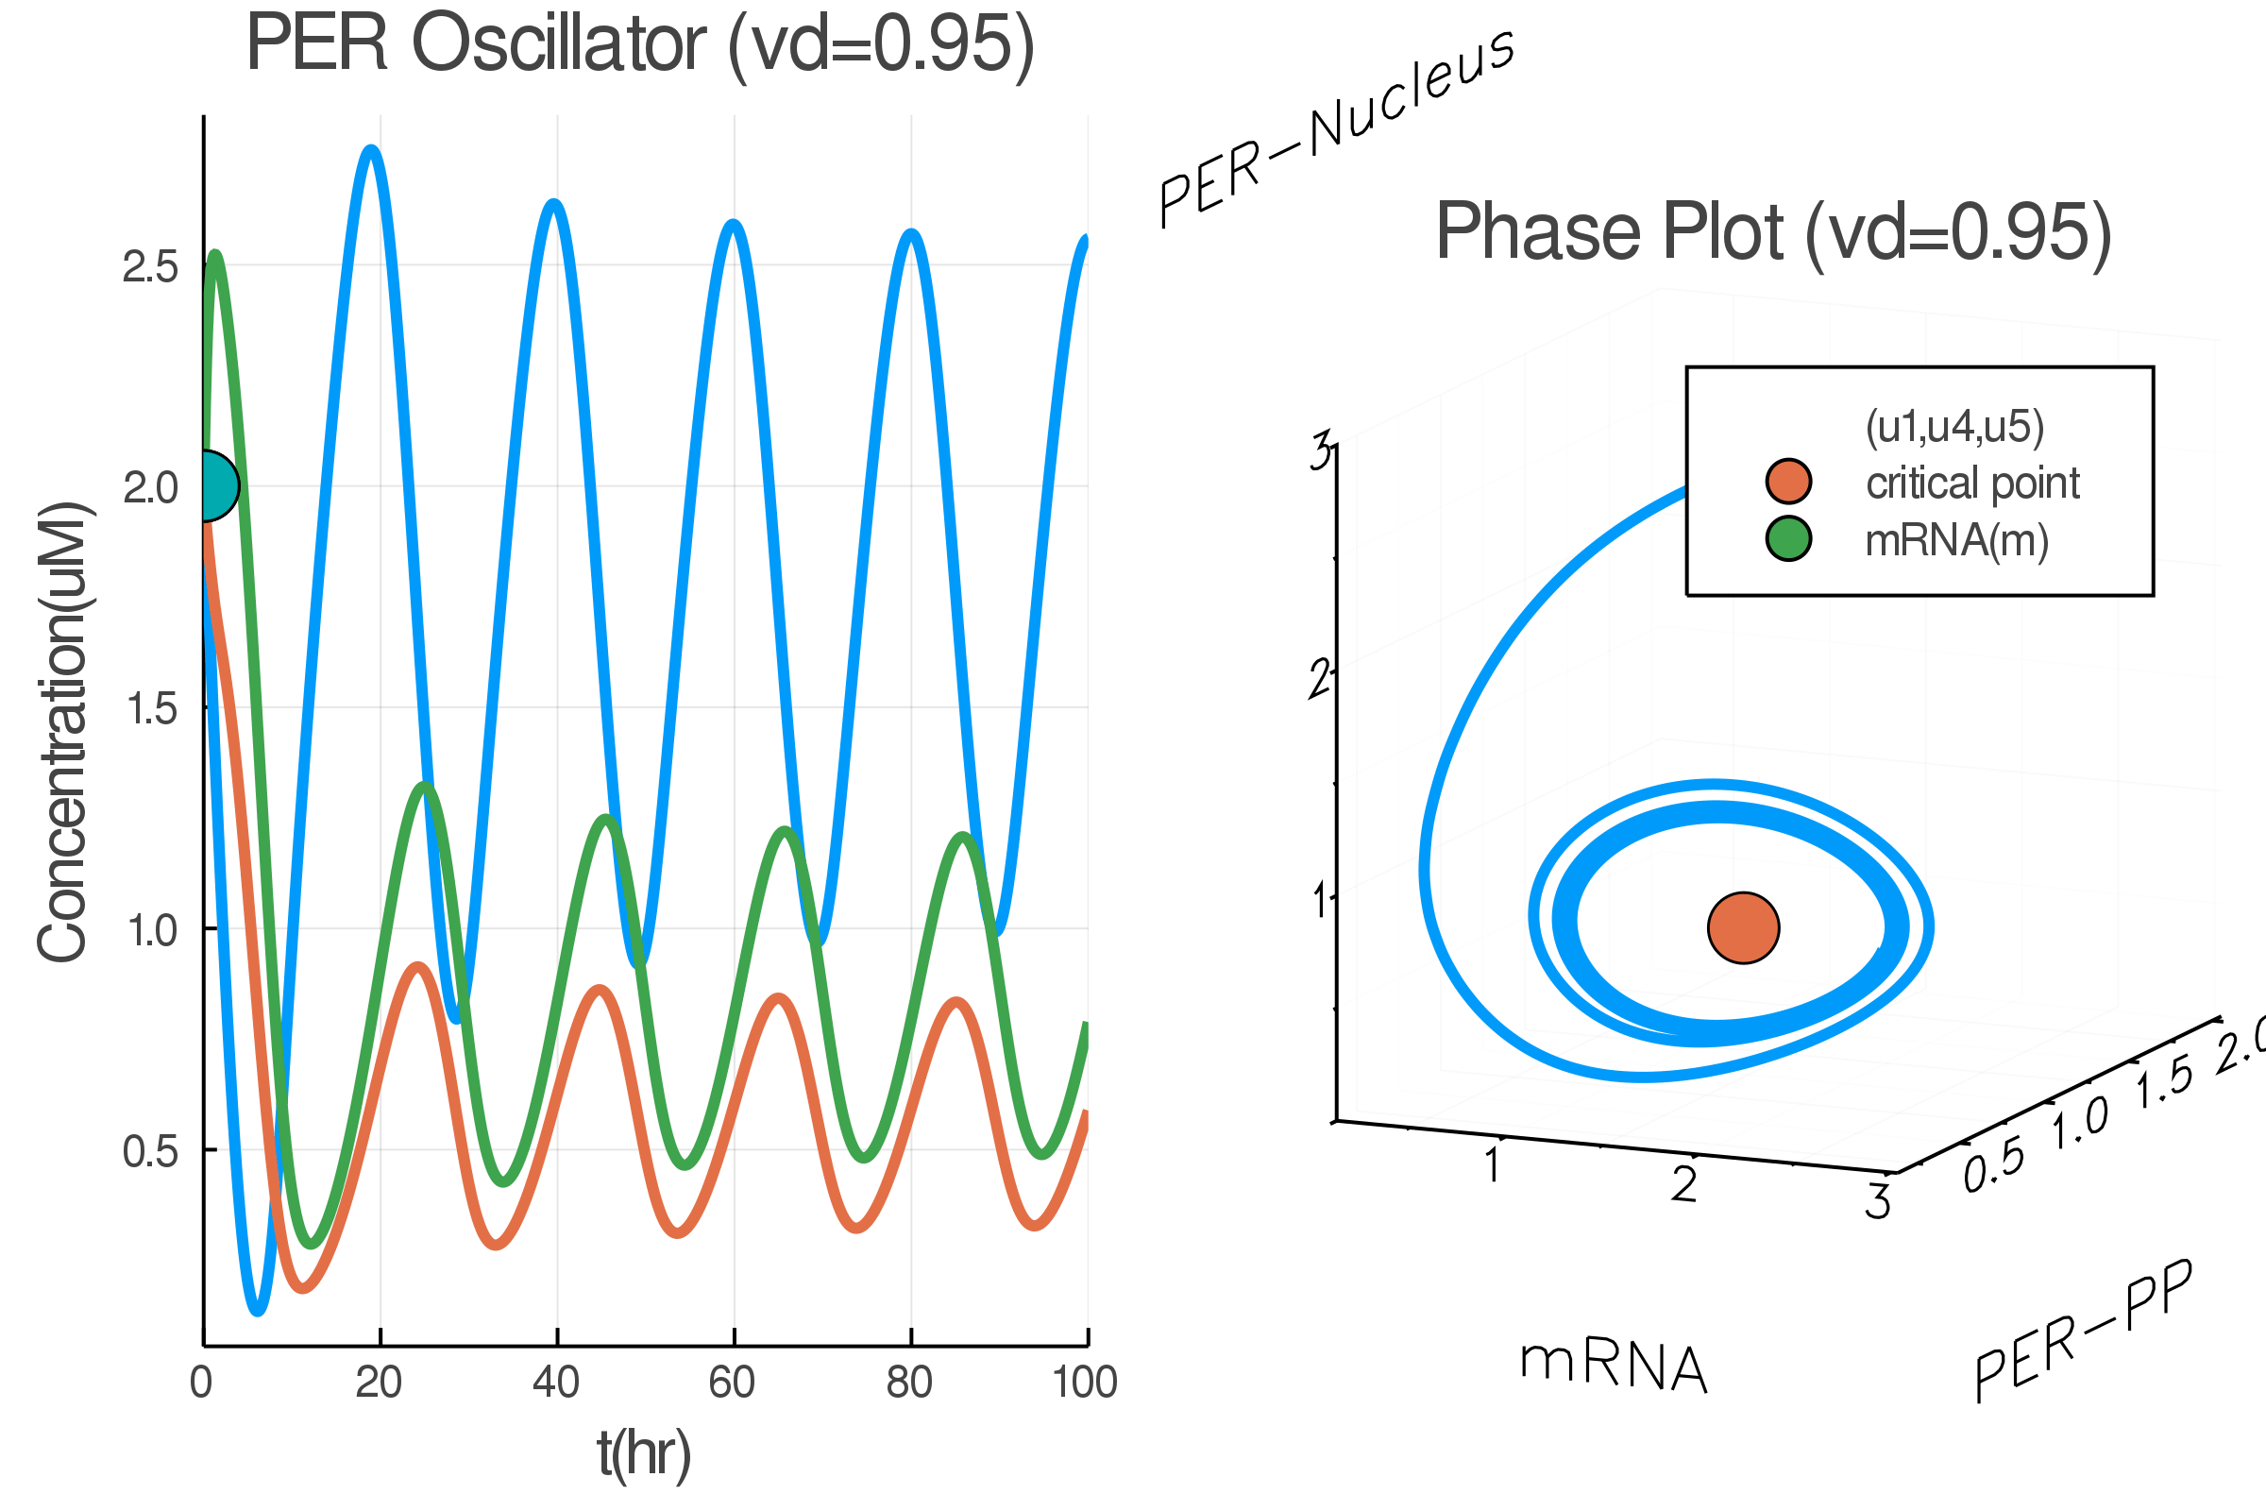
Limit Cycle
What is the phase plot?
Phase Plane
1. Trajectory of dynamical systems
2. Indicate the system behavior. Like limit cycle.
Time-series

Slide 37


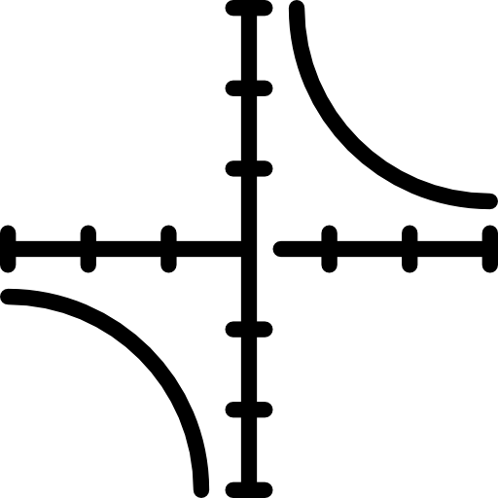
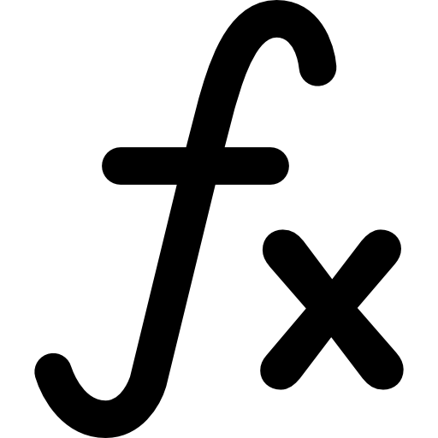
Method
How did I construct a PER model?
Build models
Simulation
Plotting
ModelingToolkit.jl
DifferentialEquations.jl
Plots.jl
https://julialang.org/
Source code: https://github.com/stevengogogo/CircadianSimulation

Slide 38

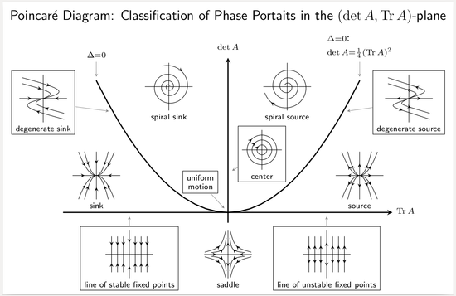
Limit Cycle
How to predict if a circadian clock ticks or not?
Simulation
Stability analysis
Critical- point criterion
dx/dt = Ax, where x is vector of agents.

Slide 39
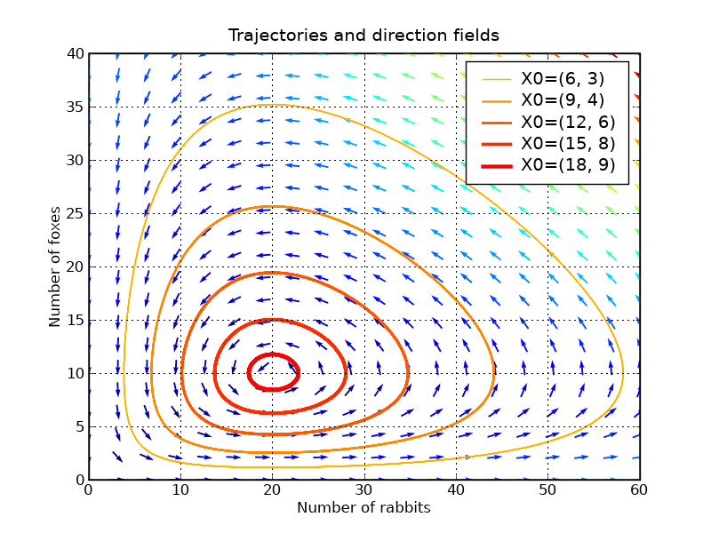
Limit Cycle
What is phase plot?
Phase Plane
1. Trajectory of dynamical systems
2. Indicate the system behavior. Like limit cycle
Phase plane can be used to visualize the gradient of motion.
🦊
🐰
https://en.wikipedia.org/wiki/Limit_cycle

Slide 40
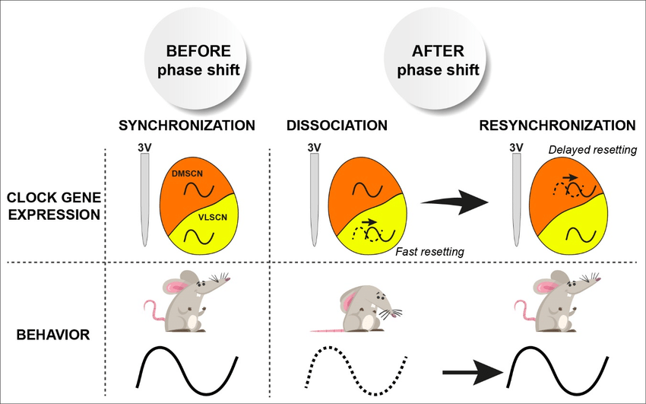

What is Jetlag?
Supplemental Materials
Beyond the cell
Synchronization of SCN is the key to functional regulation.
Phase shift cause heterogeneous impact on SCN cells.
El Cheikh Hussein et al. Molecular and Cellular Networks in The Suprachiasmatic Nuclei. (2019)

Slide 41

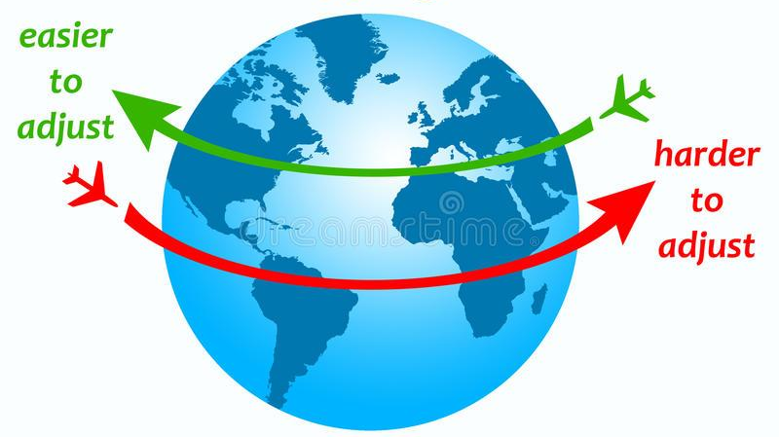
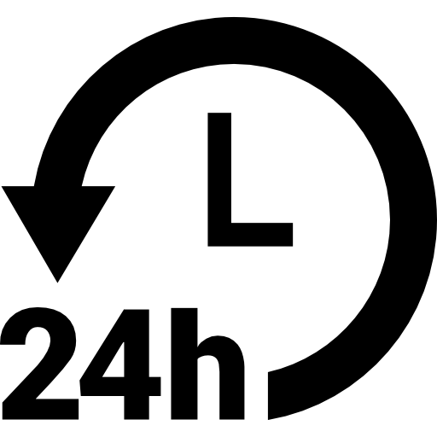
The East-West Jetlag Phenomenon
Supplemental Materials
Flying east gives you more jetlag than flying west
Human has native circadian clock of 24.5hr/period.
+
Ref.: link
Image: source

Slide 42
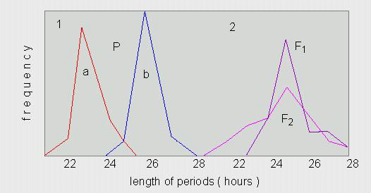
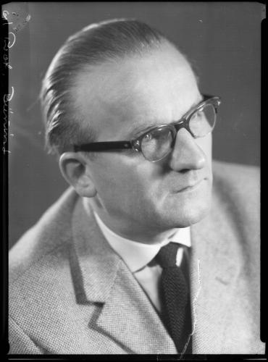
History of Circadian Discovery
The length of periods comprise 23 hours (a), 26 hours (b) and 25 hours in the F1 und F2 - hybrids (E.BÜNNING, 1932).
Erwin Bünning(1906-1990)
https://www.leo-bw.de/web/guest/detail/-/Detail/details/PERSON/wlbblb_personen/119348152/person
Notes:
歐文·邦寧的主要研究領域是植物的光週期反應。
親代生長在全暗環境下，子代仍有日週律動現象
時間週期的遺傳性

Slide 43
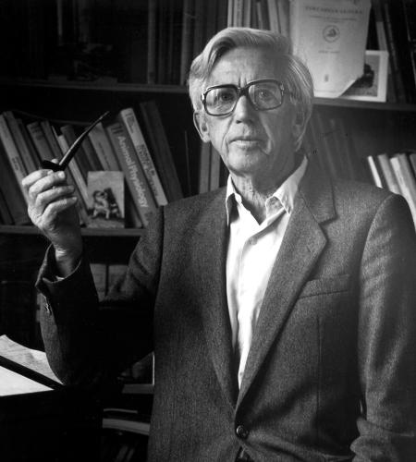
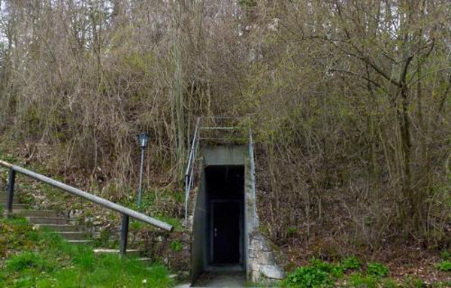
History of Circadian Discovery
Jürgen Aschoff (1913-1998)
https://www.pravda-tv.com/2013/07/chronobiologie-schlaflabor-im-bunker/
https://www.nature.com/articles/24750
Notes:
阿肖夫的地堡實驗
二戰地堡
與外界隔絕

Slide 44
參考模板

Slide 45
